Slide 1
11.7 Fourier Integral Group 6 吳正淳 張鄭心美 林柏村 林睿楚 羅弘育 陳品翔

Slide 2
1.
From Series to Integrals
Mathematical Derivation

Slide 3
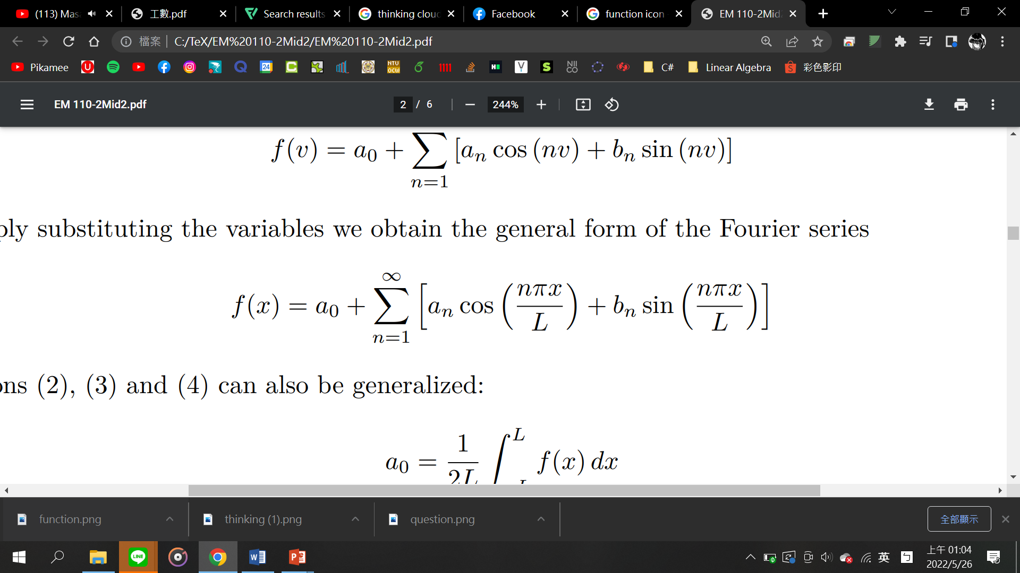
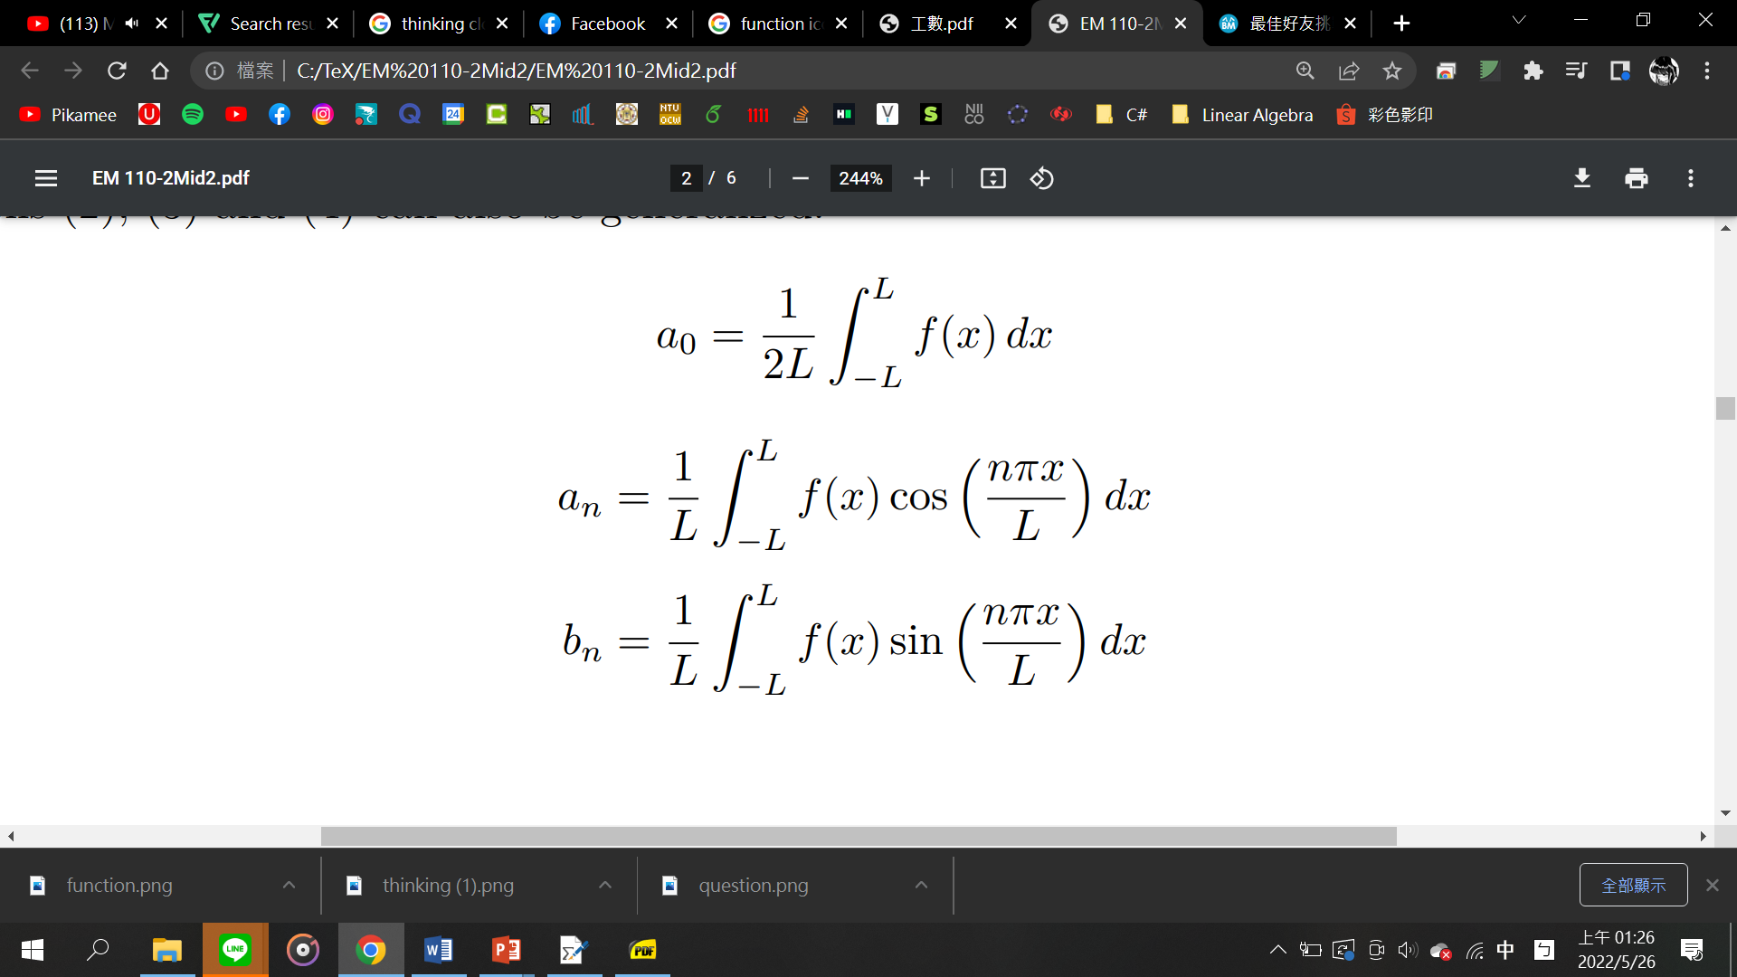
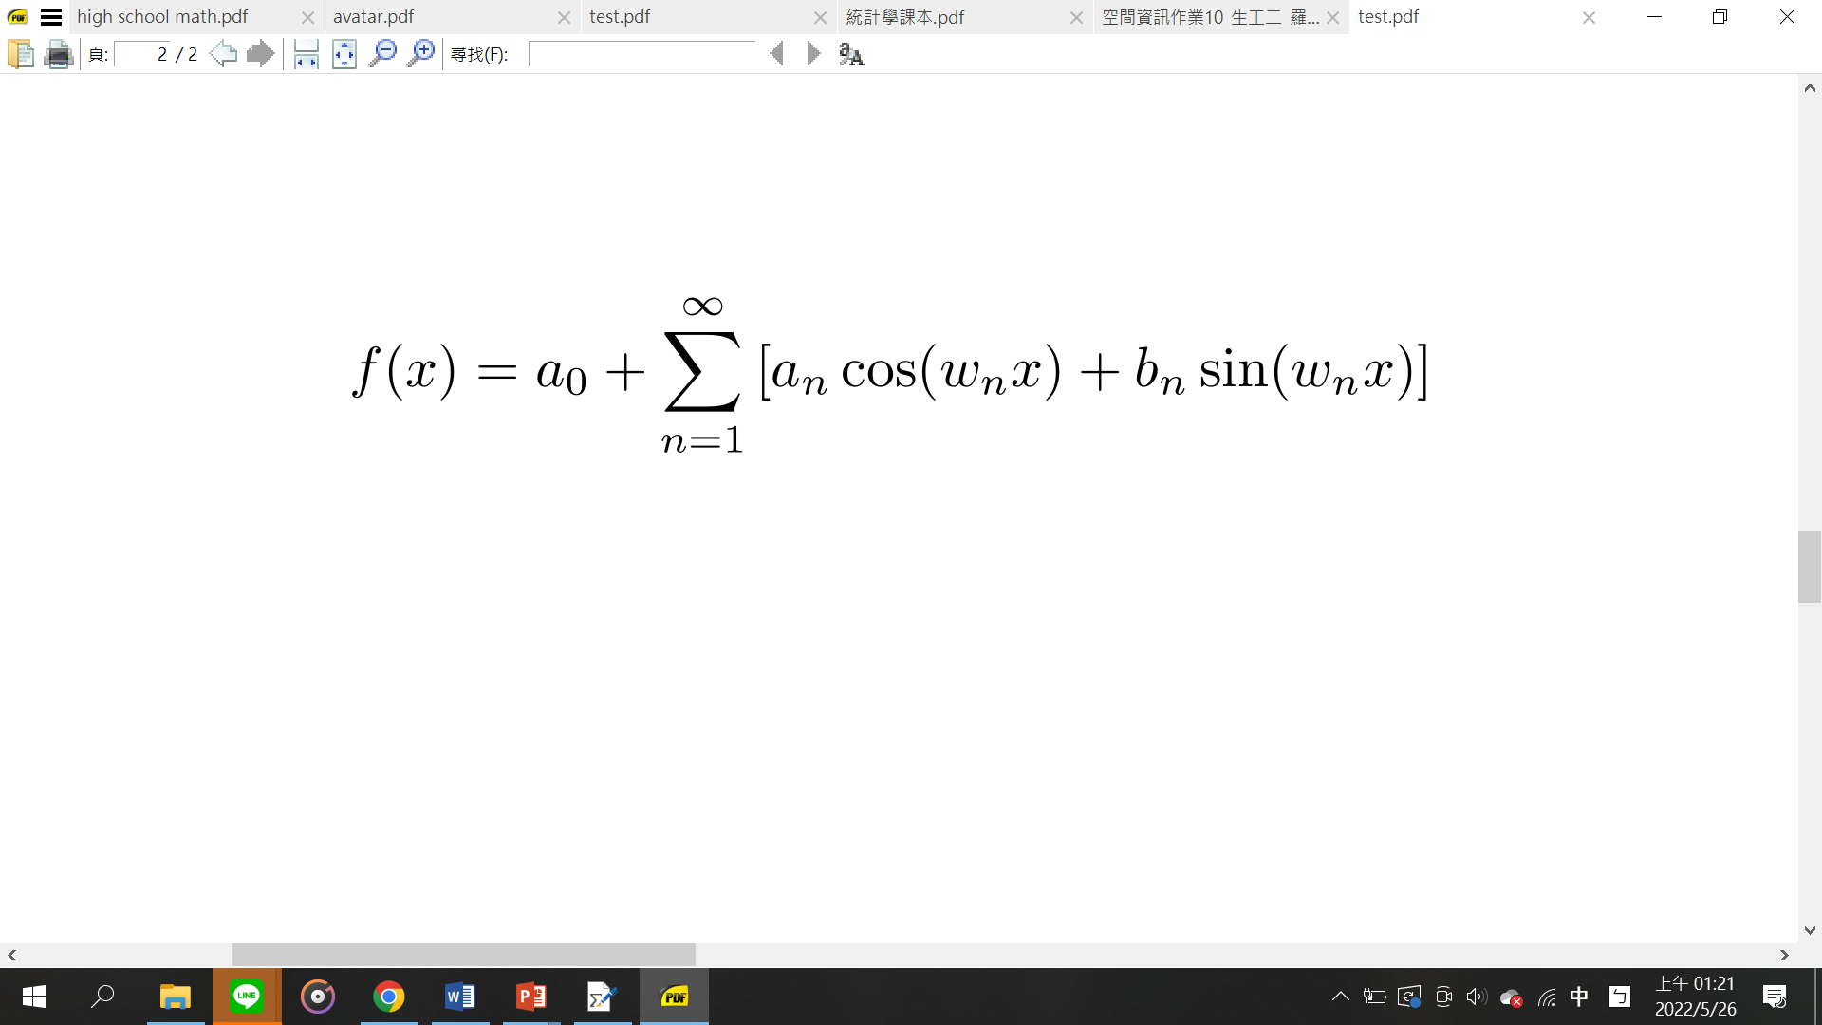
Review: Fourier Series
𝜔 = 𝑛𝜋/𝐿

Slide 4

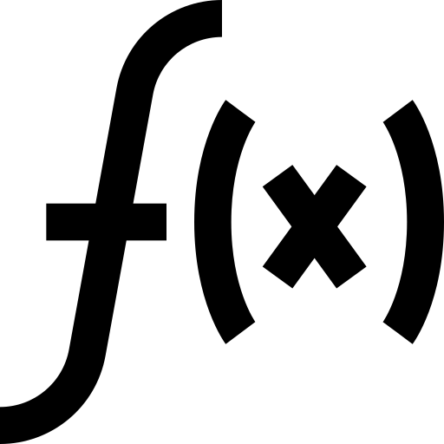
Limitation of Fourier Series
Only applicable for periodic functions.
But most functions are nonperiodic!
Hey! Maybe it’s just because you can’t see my period!

Slide 5
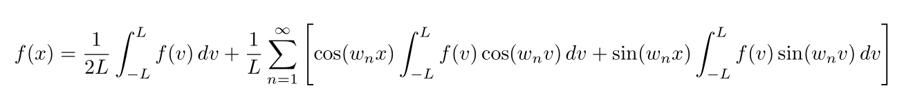
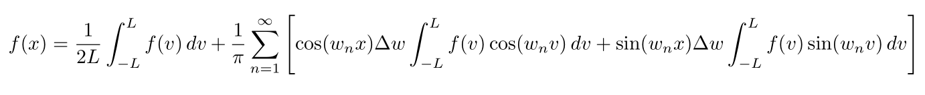
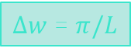
What if 𝟐𝐋 → ∞ ?
$∆w$ = $π/L$

Slide 6
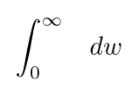
What if 𝟐𝐋 → ∞ ?
All approach to 0

Slide 7
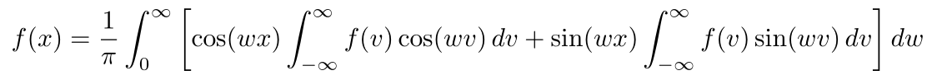
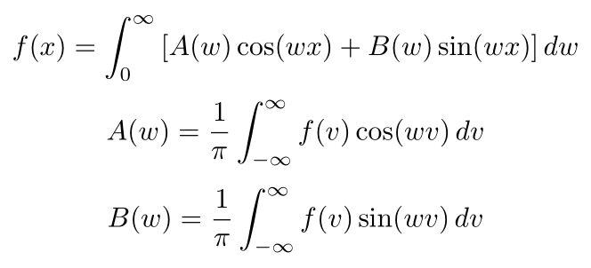
Fourier Integral
Fourier integral

Slide 8
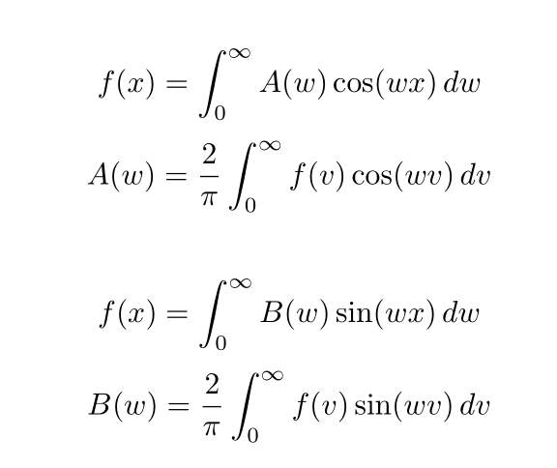
Fourier Cosine(Sine) Integral
Fourier cosine integral
Fourier sine integral

Slide 9
2.
Making Things Complex
The Complex form of Fourier Integral

Slide 10
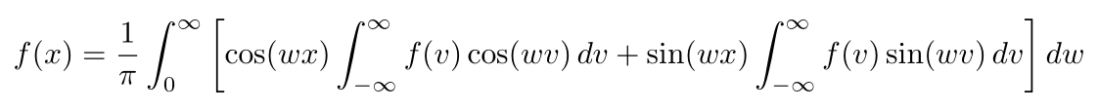
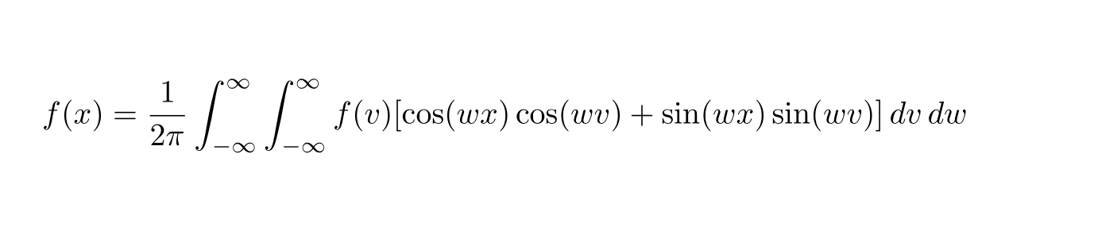
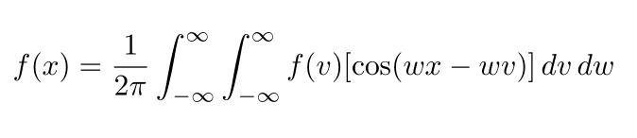
Some Trigonometry

Slide 11
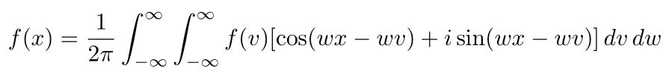

Wait... But Where does $i$ go?
Odd function contributes nothing!

Slide 12
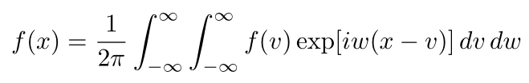
Complex Fourier Integral
But why do we need to do so?

Slide 13
3.
Epicycles: Introduction
Application of Complex Fourier Integral

Slide 14
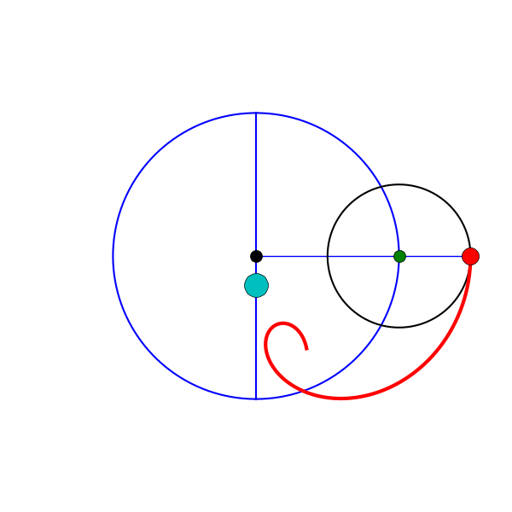
“Circle Moving on Another Circle”
https://www.astronomy.ohio-state.edu/pogge.1/TeachRes/Artwork/Anims/index.html

Slide 15
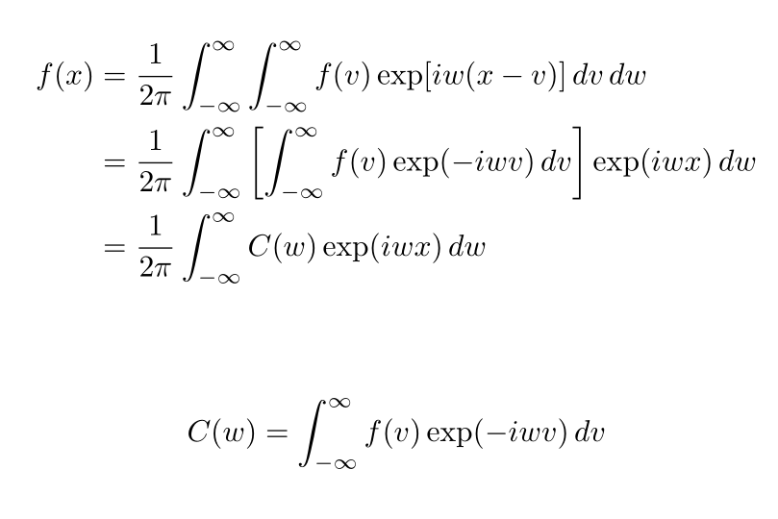
In order to do so...

Slide 16
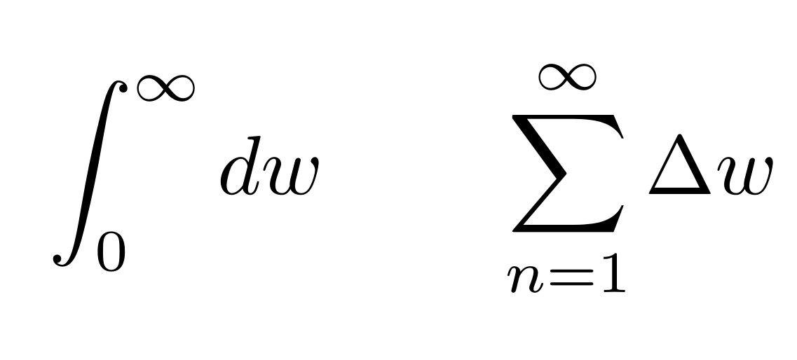
At the End of the Day...
Computation by machines is discrete.
Approximation
Generalization

Slide 17
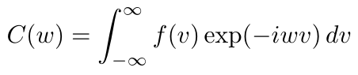
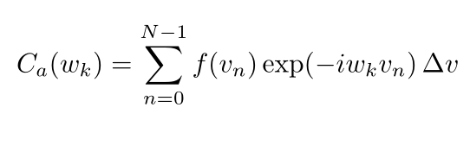
Discrete Fourier Transform (DFT)
Taking N samples

Slide 18
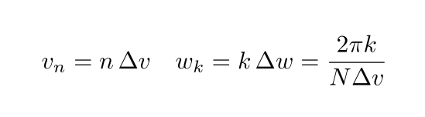
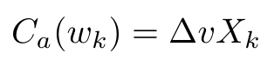
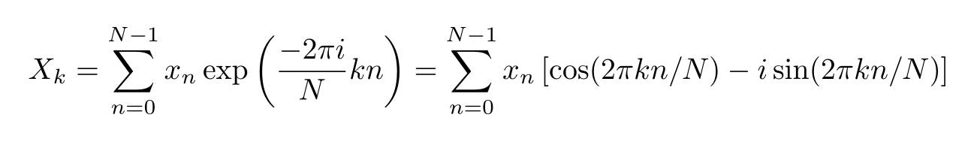

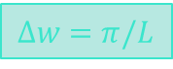
Discrete Fourier Transform (DFT)
𝜔 = 𝑛𝜋/𝐿
$∆w$ = $π/L$
𝜔 = 𝑛 $∆w$

Slide 19
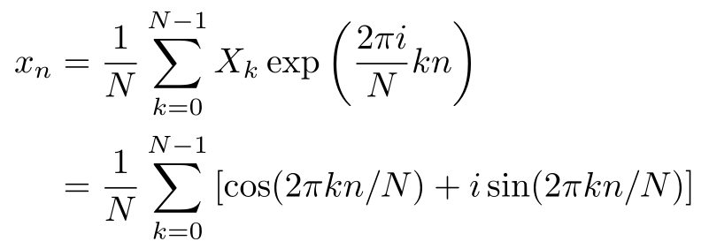
Inverse DFT (IDFT)
Circle in the complex plane!

Slide 20
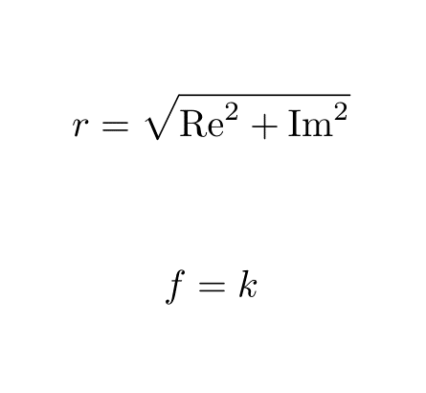
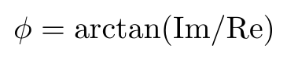
How to Make Circles?
Radius
Frequency
Phase

Slide 21
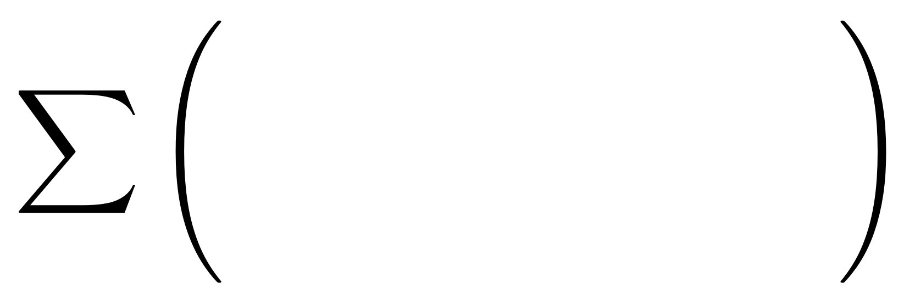
How to Make Circles?
Radius
Frequency
Phase
The original function!

Slide 22
4.
Epicycles: from Image to Function
Function Representation of images

Slide 23


Objective
Image
Coefficients
Function
Replot
DFT
IDFT
continuize
?

Slide 24
What is Function?
x
x
In mathematics, a function from a set X to a set Y assigns to each element of X exactly one element of Y.
3
4
1
2
1
1
1
1
6
1
3
4
2
2
6
2
6
5
3
3
3
2
3
y
3
y
5
1
2
4
4
4
1
2
5
5
4
3
5
5
4
6
2
6
6
6
3
5
6
6

Slide 25
Functions of Indices
x
1
2
3
4
6
x(0) = 1
x(5) = 3
x(10) = 5
3
4
6
x(1) = 2
x(6) = 4
·
·
2
3
5
6
·
x(2) = 3
x(7) = 6
·
·
1
2
5
·
1
2
3
4
x(3) = 4
x(8) = 2
x(22) = 5
2
3
4
5
6
x(4) = 6
x(9) = 3
x(23) = 6

Slide 26
Functions of Indices
?
[x(i), y(i)]
How to determine effective pixels?
How to sequence the pixels?
Edge Detection
Smallest Distancing

Slide 27
5.
Epicycles: Edge Detection
Image Pre-processing

Slide 28
What is Edge?
Drastic Change of Color!

Slide 29
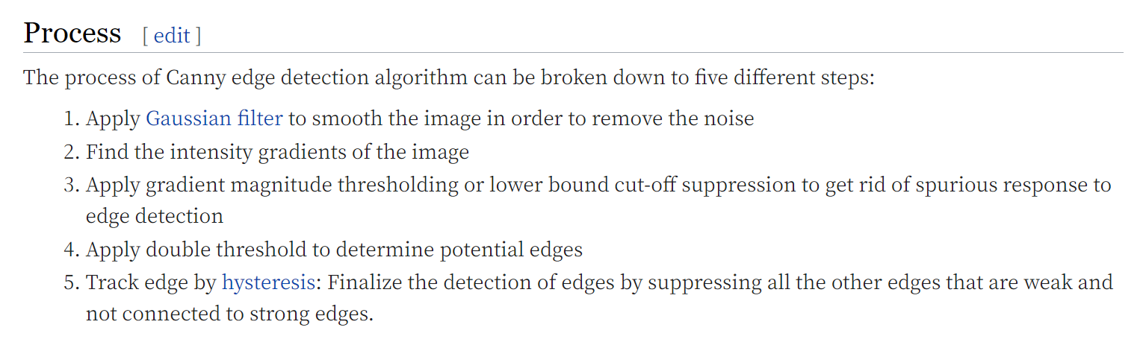
Canny

Slide 30


Gaussian Blur
Original Image
After Gaussian Blur

Slide 31


Denoising
Image with Noise
After Gaussian Blur

Slide 32
Canny

Slide 33

OpenCV
Facial / gesture recognition
Motion tracking
ML libraries
ML libraries

Slide 34
6.
Epicycles: Coding
Implementing ideas by Java and Python

Slide 35
7.
Epicycles: Results and Conclusion
Discussion Based on Observed Phenomenon

Slide 36
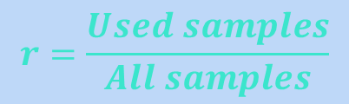
Cons of Approximation
Few samples results in terrible approximation.
Points Usage Rate
$$r=\frac{Used samples}{All samples}$$

Slide 37

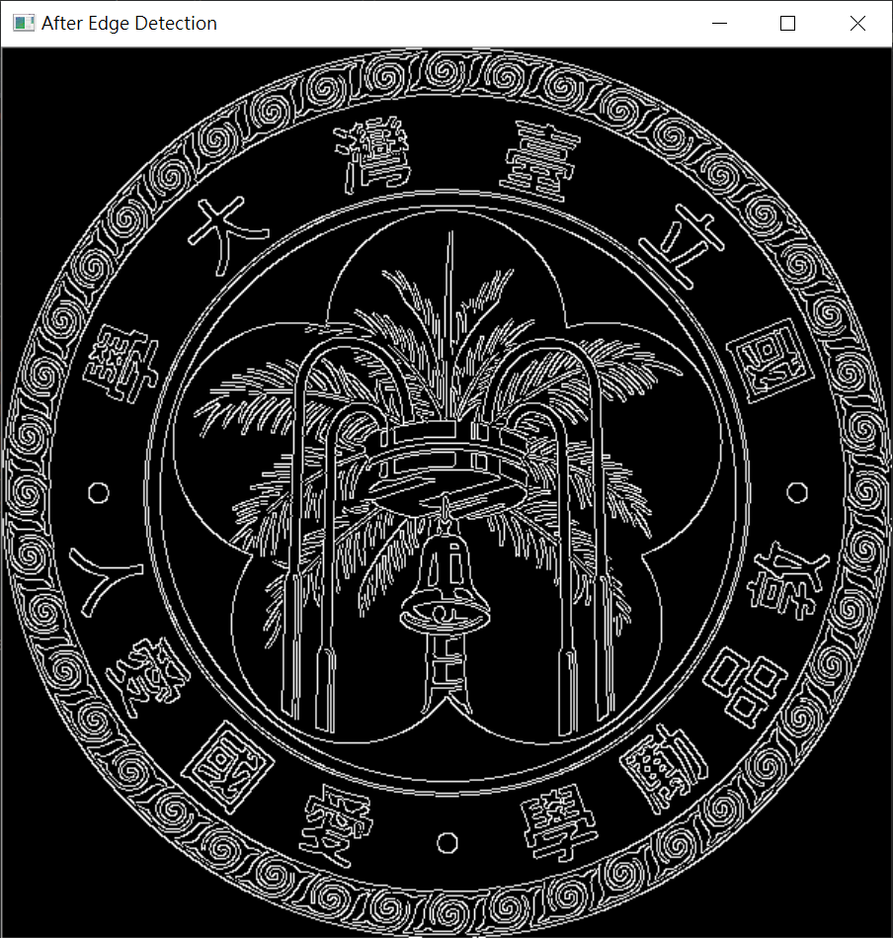
Test Case: NTU Emblem
Canny
Total white pixels: 47264

Slide 38
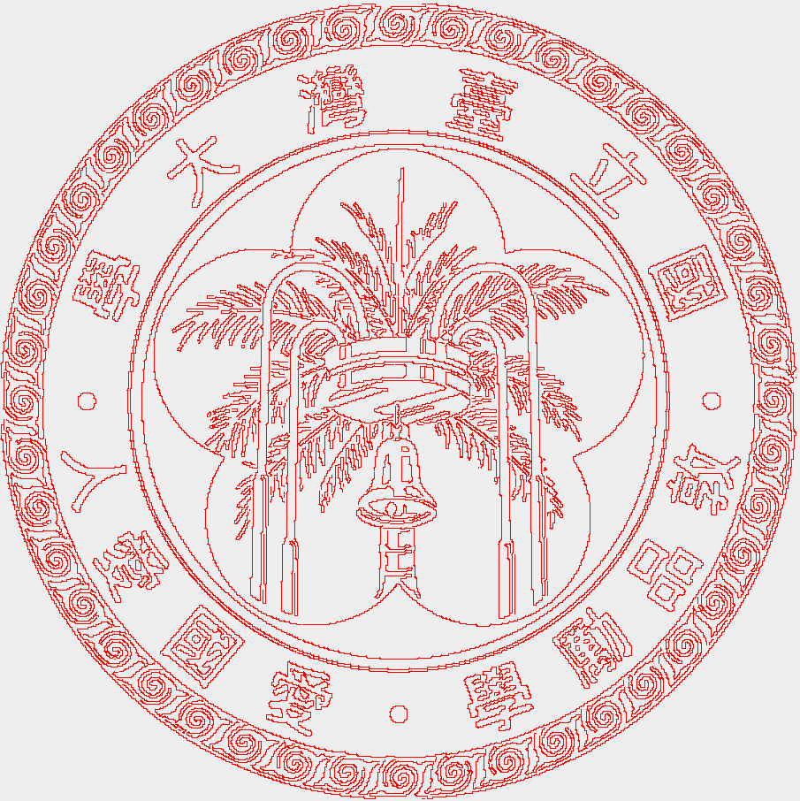

All samples Used ($r=1$)
Original Image
After Canny
After DFT and IDFT

Slide 39
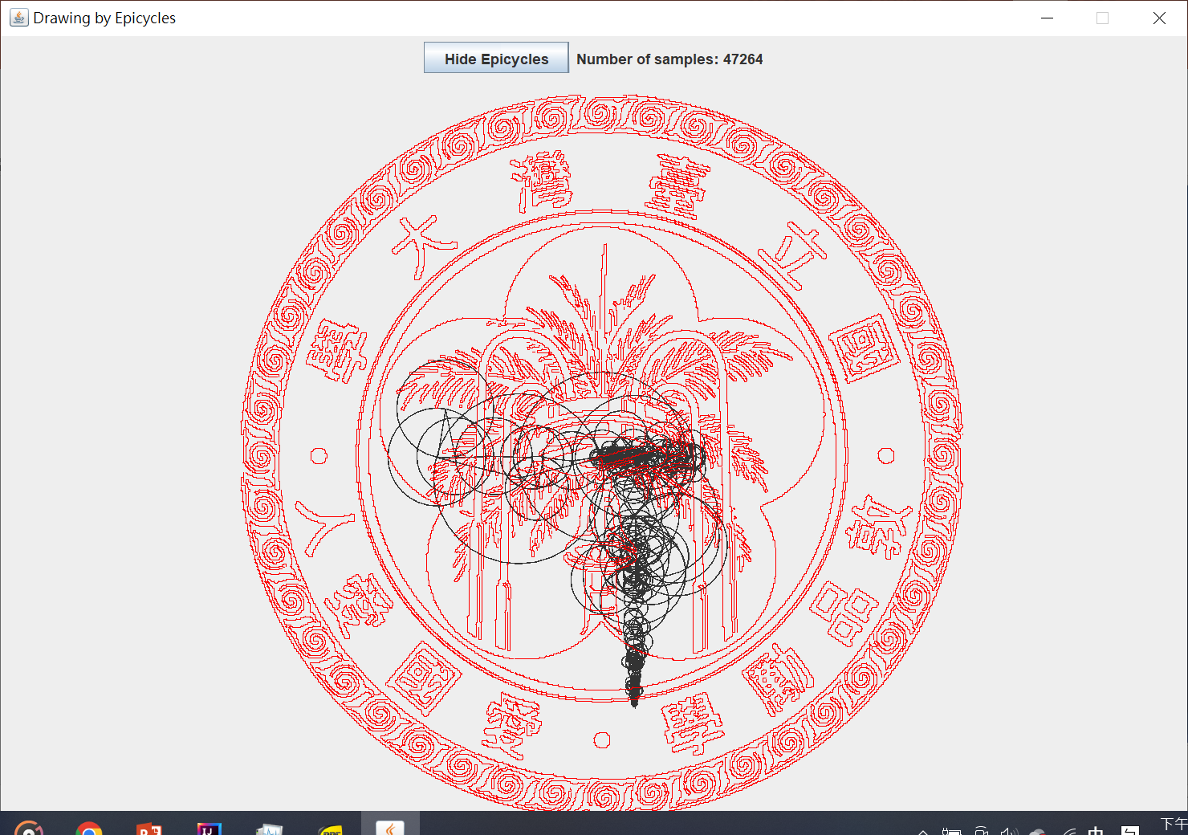
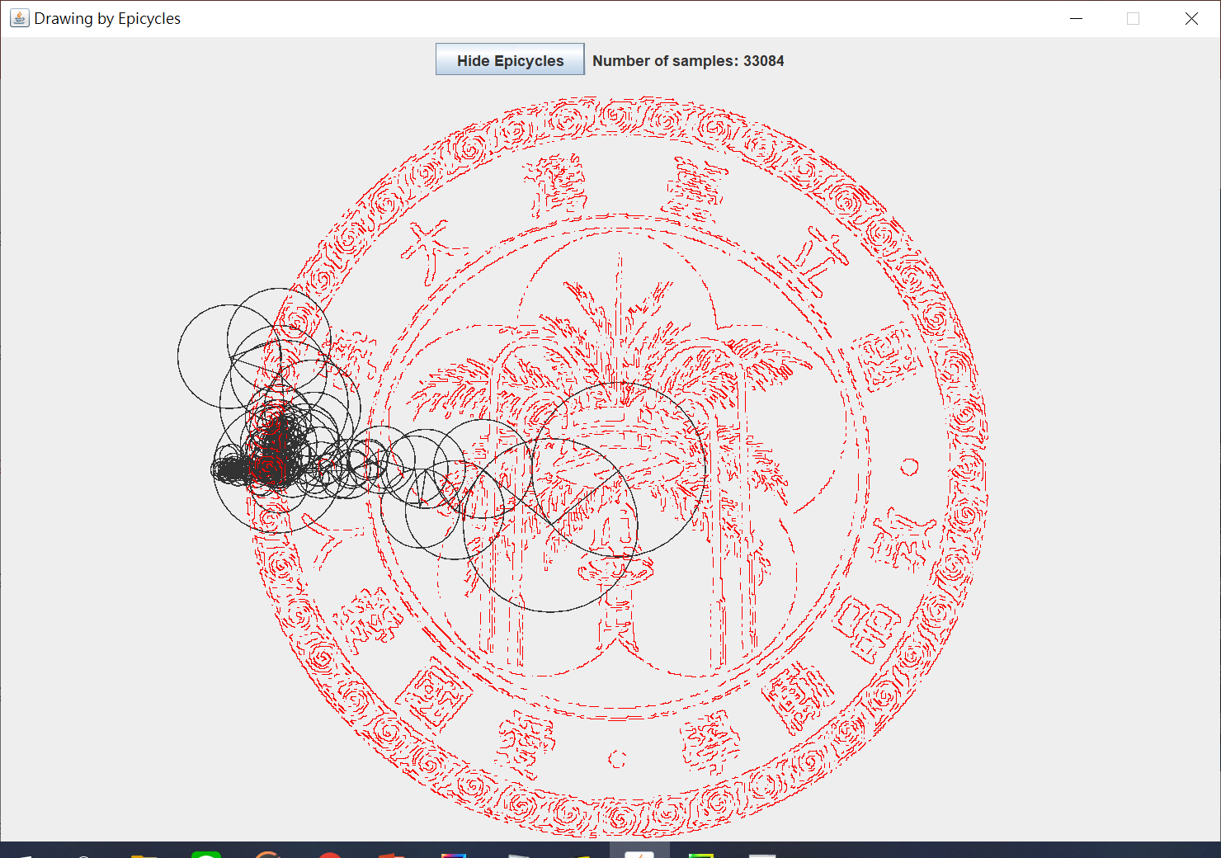
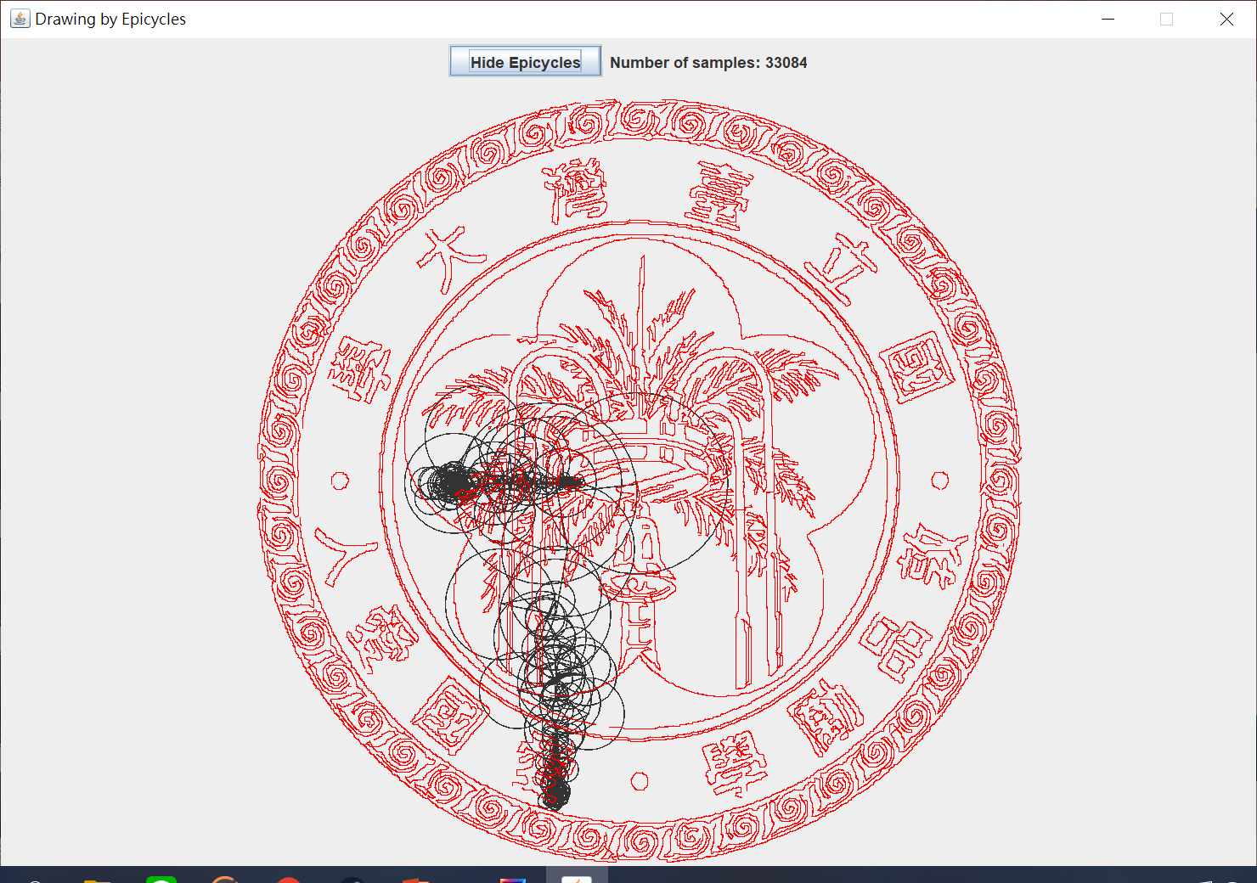

$r=1$ vs. $r=0.7$

Slide 40
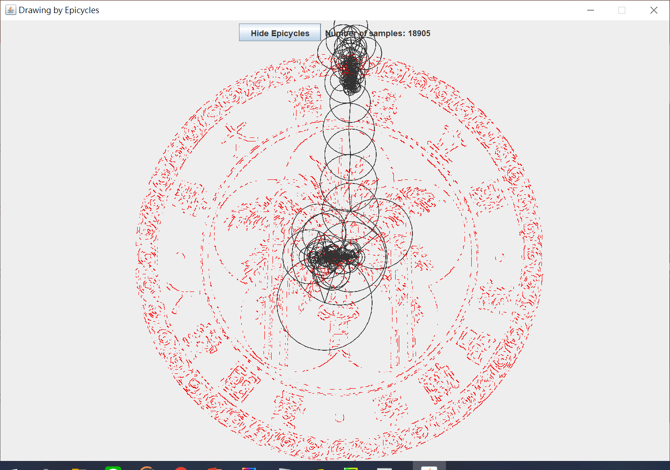
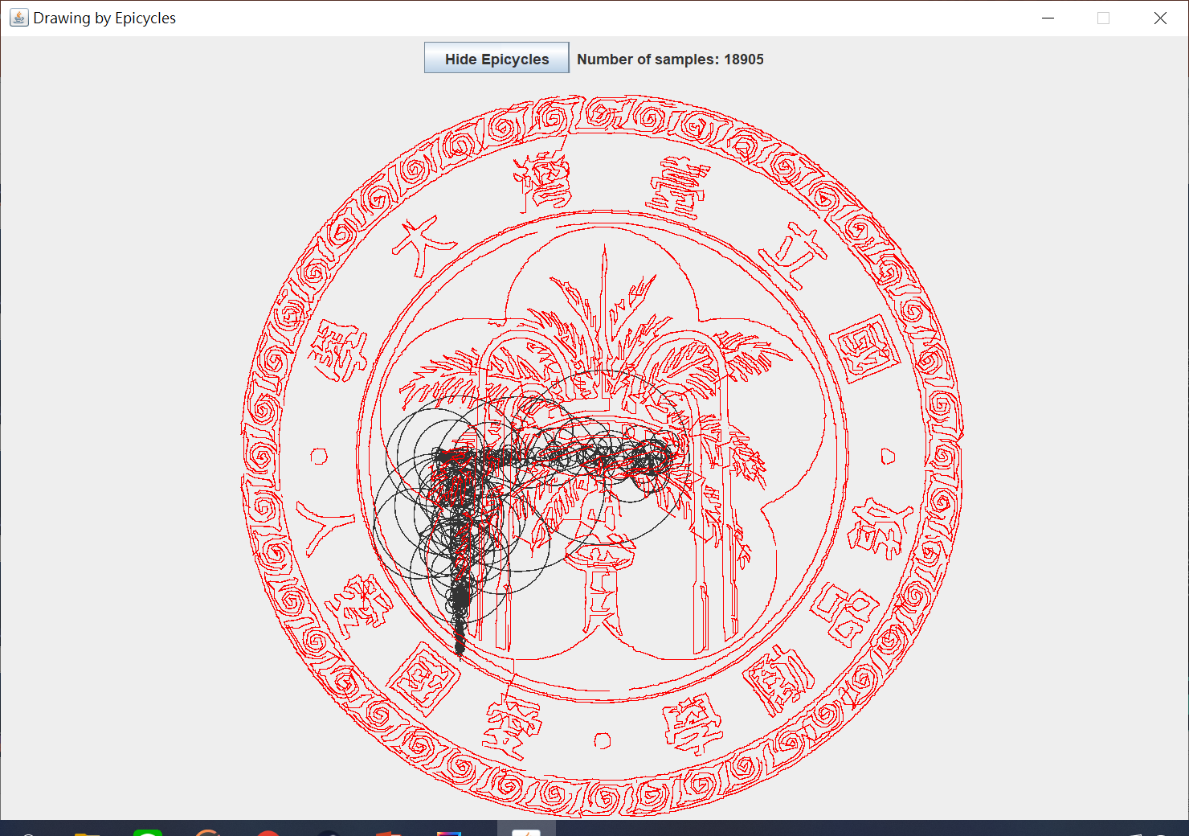

$r=1$ vs. $r=0.4$

Slide 41
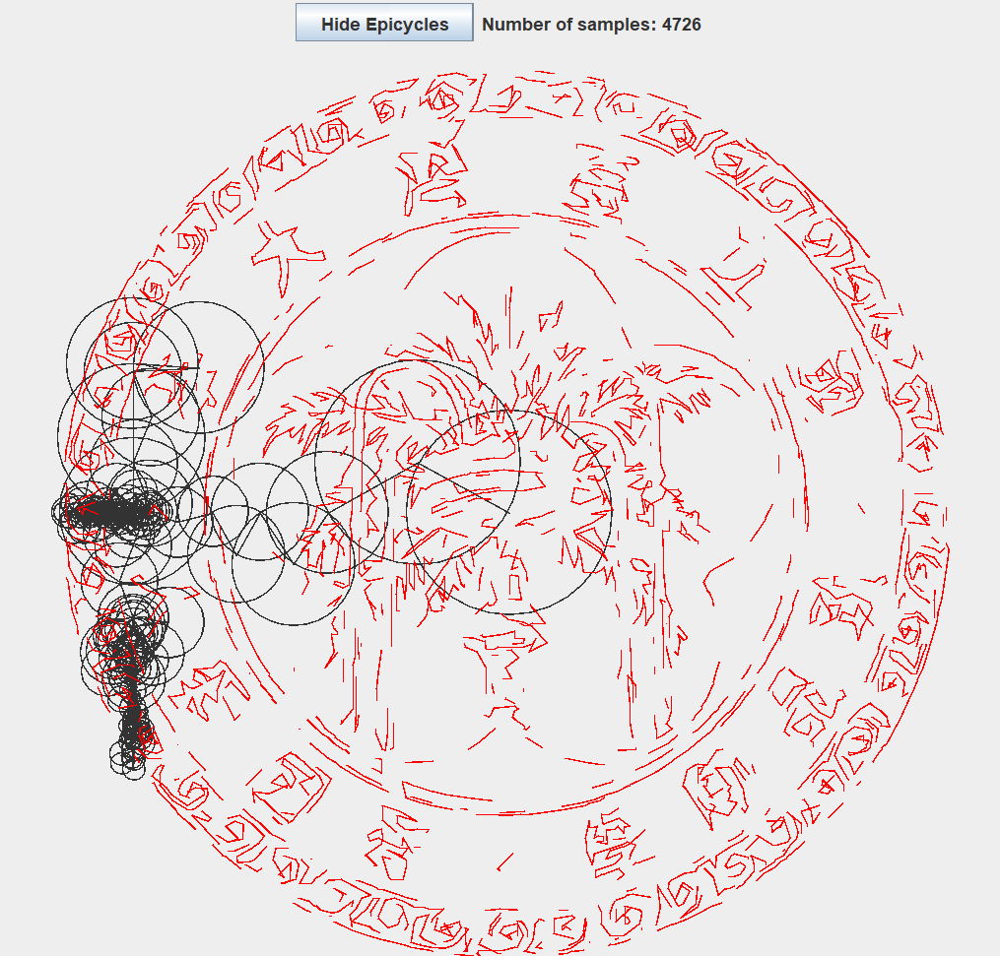

$r=1$ vs. $r=0.1$

Slide 42

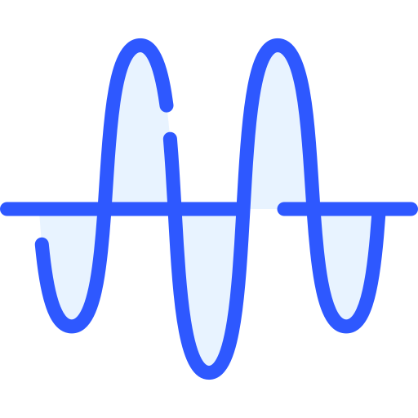

Why Bother Doing DFT?
File Compression
Signal Filtering
Solving PDEs

Slide 43

What’s more...
How to generate a JPEG file?
https://blog.csdn.net/newchenxf/article/details/51719597
Any faster way to do DFT?
https://www.youtube.com/watch?v=h7apO7q16V0&t=208s
https://github.com/MrXP0108?tab=repositories

Slide 44
Thanks for Listening!

